Slide 1
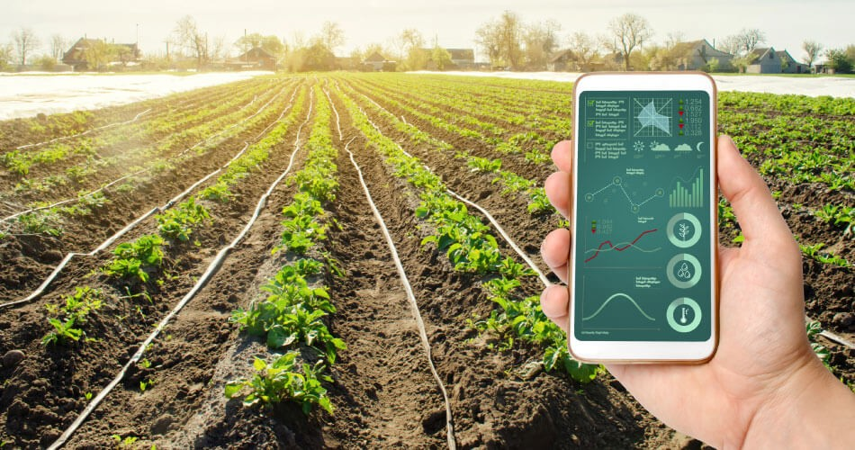
Crop Production Analysis in India

Slide 2
Introduction
This project focuses on analyzing crop production trends across different states and districts in India. Using historical data, we aim to identify key factors that influence crop yields and provide insights into how area and production vary over time. Visualizations such as heatmaps, bar charts, and slicers for crop type and quarters help to uncover significant patterns, enabling better decision-making in the agriculture sector.

Slide 3
Details of Data
The dataset used for this analysis contains comprehensive information on crop production in India across multiple years. Key columns include:
State Name: Identifies the states where crops are grown.
District Name: Provides district-level granularity for crop data.
Crop Year: Represents the year in which crop production took place.
Season: Specifies the agricultural season (e.g., Kharif, Rabi) for each crop.
Crop: Names the crop being produced (e.g., Rice, Wheat).
Area: Denotes the total area (in hectares) allocated for crop cultivation.
Production: Records the actual crop production (in tons).
This dataset enables us to analyze regional variations in crop production and the factors affecting yield outcomes.
Crop Production Analysis in India

Slide 4
Main KPIs
1.Total Crop Production:
Overall crop yield (in tons) across all regions.
2.Average Yield per Hectare:
Efficiency of land use, calculated as production divided by area.
3.Area Under Cultivation:
Total land (in hectares) used for crop cultivation.
4.Production by Crop:
Breakdown of total production by crop type.
5.Production by State/District:
Crop output segmented by region to highlight top-performing areas.
Crop Production Analysis in India

Slide 5
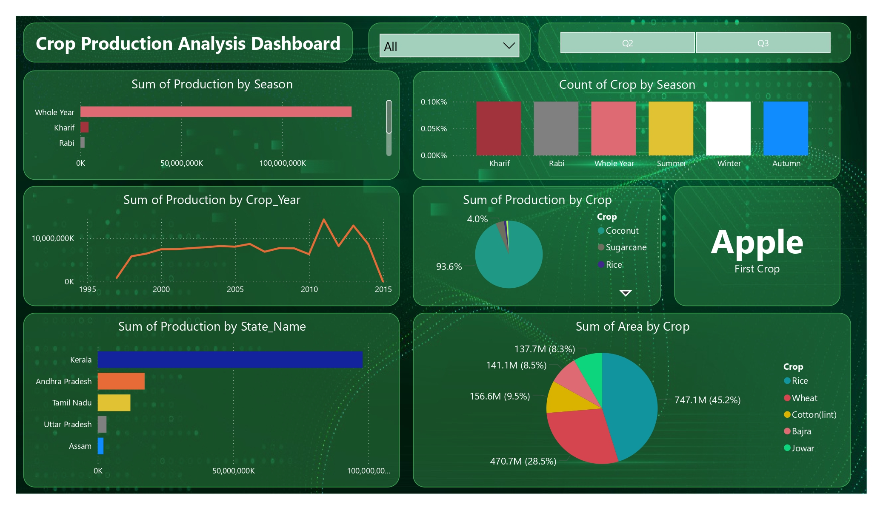
My Design
Crop Production Analysis in India

Slide 6
Thank you
17/10/2024
Crop Production Analysis in India

